Slide 1

Ch.10 Working with your MySQL Database
Siva R Jasthi
ICS325 – Unrestrictedet Application Development
Information and Computer Sciences
Metropolitan State University

Slide 2
Outline
Inserting data into the database
Retrieving data from the database
Joining Tables
Using Sub queries
Updating records from the database
Altering tables after creation
Deleting records from the database
Dropping tables

Slide 3
Revisiting SQL
SQL = Structured Query Language
Is a standard language for the RDBMS
Used in MySQL, oracle, PostgreSQL, Sybase, Microsoft SQL server
DDL (Data Definition Language) – Covered in Chapter 9
DML (Data Manipulation Language) – We will cover in Chapter 10.
DDL is one shot deal (typically)
DML is used more frequently (updates, deletes, access)

Slide 4
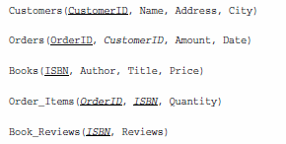
Book-O-Rama example
Book-O-Rama Schema:
Primary Key for each table is underlined
And each foreign key is italic.

Slide 5


Setting up a User for the web
For PHP Scripts to connect to MySQL, it is recommended to create another user with the privileges typically needed on web
SELECT, INSERT, DELETE, UPDATE
For some additional sophistication, you can also create the user as follows (with additional privileges of ..)
INDEX, ALTER, CREATE, DROP

Slide 6
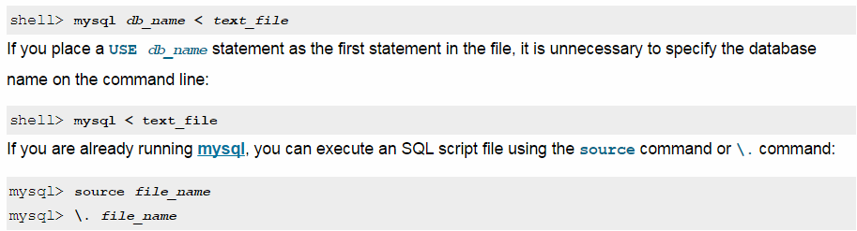
You can run the SQL commands from a file
(see Chapter 9 / bookorama.sql)
mysql> source D:\_PHP\BOOK ON CD Contents\Source\Chapter09\bookorama.sql
Query OK, 0 rows affected (0.03 sec)
Query OK, 0 rows affected (0.03 sec)
Query OK, 0 rows affected (0.02 sec)
Query OK, 0 rows affected (0.02 sec)
Query OK, 0 rows affected (0.03 sec)
mysql –h host –u bookorama –D books –p < bookorama.sql

Slide 7
Revisiting SQL
SQL = Structured Query Language
Is a standard language for the RDBMS
Used in MySQL, oracle, PostgreSQL, Sybase, Microsoft SQL server
DDL (Data Definition Language) – Covered in Chapter 9
DML (Data Manipulation Language) – We will cover in Chapter 10.
DDL is one shot deal (typically)
DML is used more frequently (updates, deletes, access)

Slide 8

Inserting Data into a Database Table
Syntax
All values
Only 2 columns
Alternate syntax

Slide 9
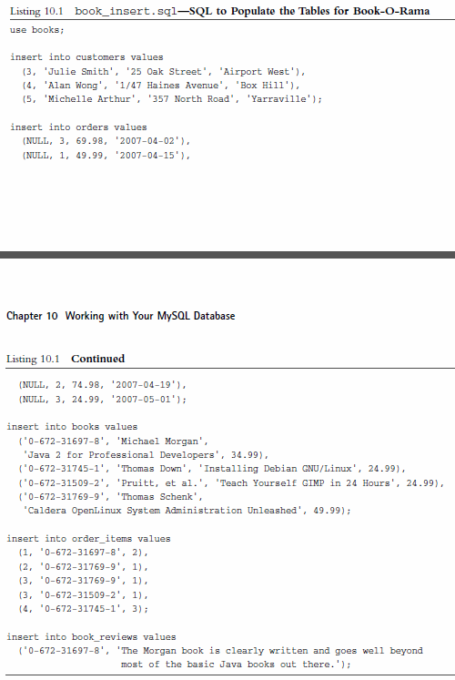
SQL to populate the Tables for Book-O-Rama

Slide 10
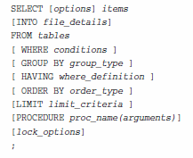


Retrieving Data from the Database
Workhorse of SQL is SELECT statement;
Selecting two columns from customers
Using wildcard *; Selecting all columns from order_items

Slide 11
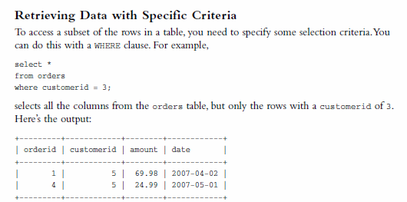
Retrieving Data with specific criteria
(WHERE clause)
IT
IS
5

Slide 12
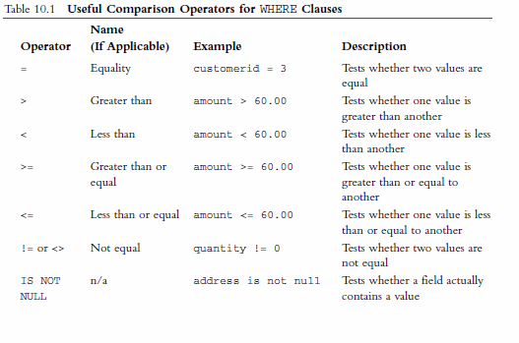
Comparison Operators for WHERE clause

Slide 13
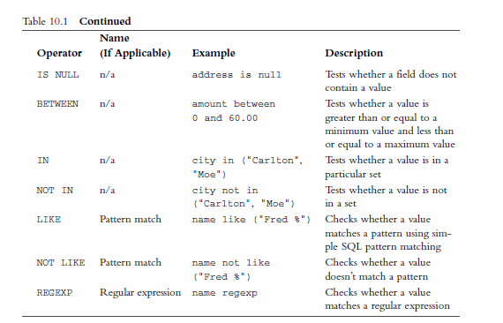
Comparison Operators for WHERE clause (Cond.)

Slide 14
Comparison Operators for WHERE clause (Cond.)

Slide 15
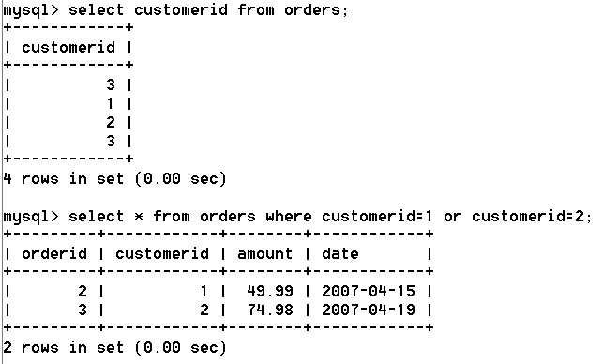

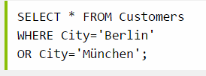
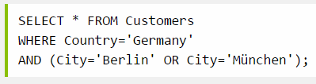
AND, OR operators for where clauses

Slide 16
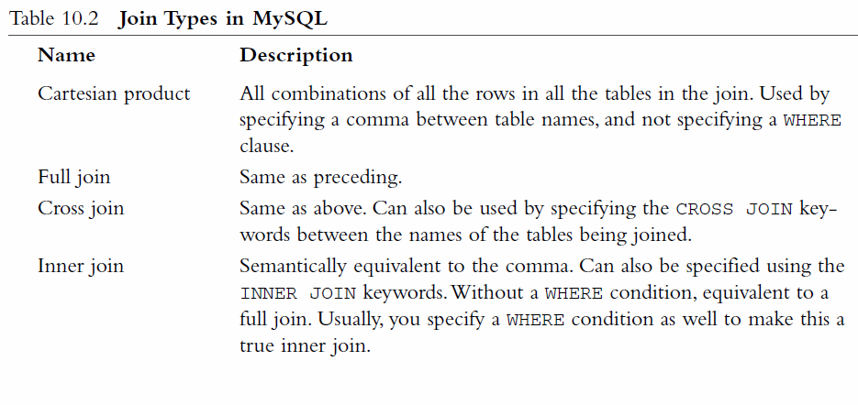
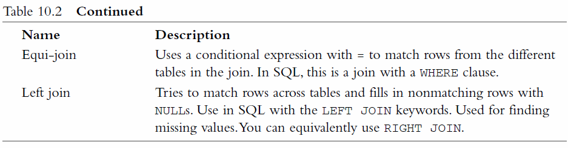
Retrieving Data from Multiple Tables
SQL Joins: http://www.w3schools.com/sql/sql_join.asp
The basic concept is: There is data spread across multiple tables (because of database normalization principles 1NF, 2NF and 3NF)
However, the data need to be fetched as a logical unit and it means going after multiple tables.
JOINS come into picture here. There are several types of Joins in MySQL.

Slide 17
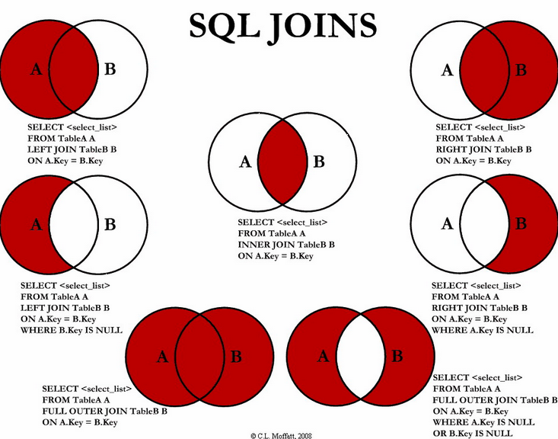

Slide 18
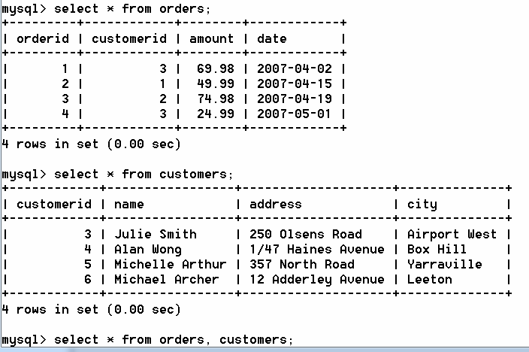
INNER JOIN or CROSS JOIN
FULL JOIN
CARTESIAN PRODUCT
How many rows are returned by this FULL JOIN?
The combined table doesn’t make sense.
Rows are combined with brute force.
Each row in orders is combined with each row in customers.

Slide 19
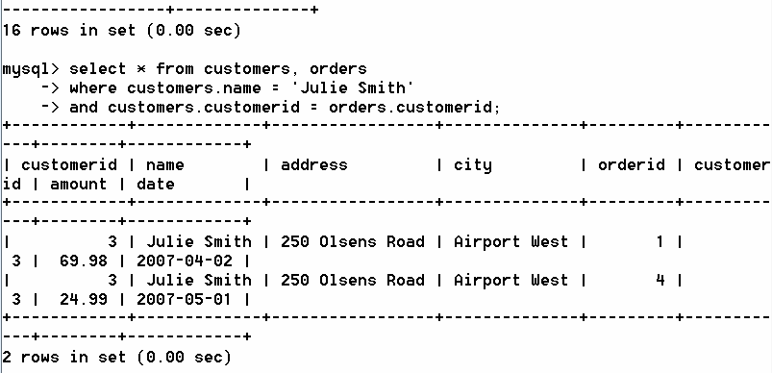
EQUI-JOIN through WHERE clause
When you specify WHERE clause, it is called “equi-join”.

Slide 20
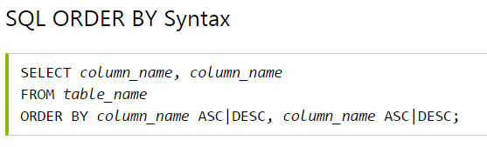




ORDER by Clause
The ORDER BY keyword is used to sort the result-set by one or more columns.
The ORDER BY keyword sorts the records in ascending order by default. To sort the records in a descending order, you can use the DESC keyword.

Slide 21
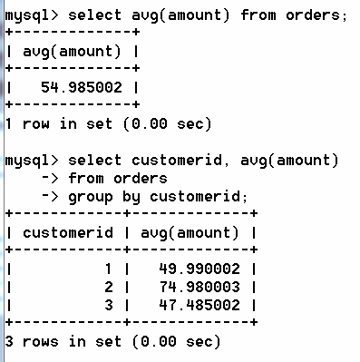
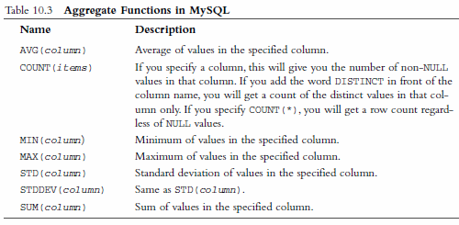
Grouping and Aggregating Data
The aggregate functions (example: what is the average price of an item in an order? What is the average sale per customer in the month of December?) can be applied to the whole table or a select set of data.

Slide 22
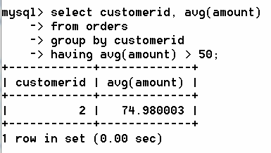
HAVING clause (filtering out some data based on some criteria)
In addition to grouping and aggregating data, we can also test the result of an aggregate by HAVING clause.
It comes straight after the GROUP BY clause and is like a WHERE that applies only to groups and aggregates
Adding “having” clause

Slide 23
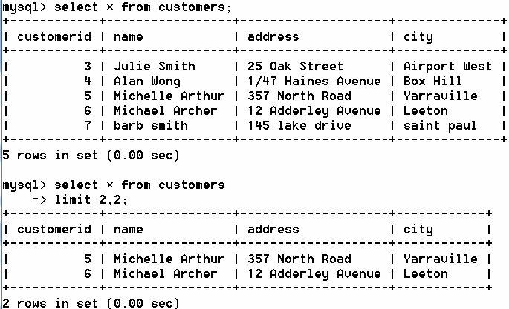
Choosing which rows to return
One clause of the SELECT statement that is particularly useful in web applications is LIMIT.
It is used to set limits on how many rows need to be returned.
It takes two parameters: Starting row number and number of rows.

Slide 24
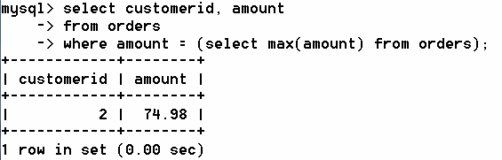
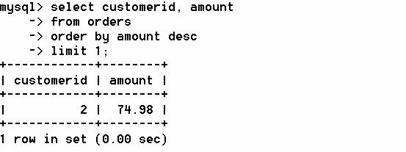
Using Subqueries
A subquery is a query that is nested insider another query;
Most subquery functionality can be achieved with careful use of joins and clauses. However, subqueries can be easier to read and write.
With Sub Query
With out Sub Query

Slide 25

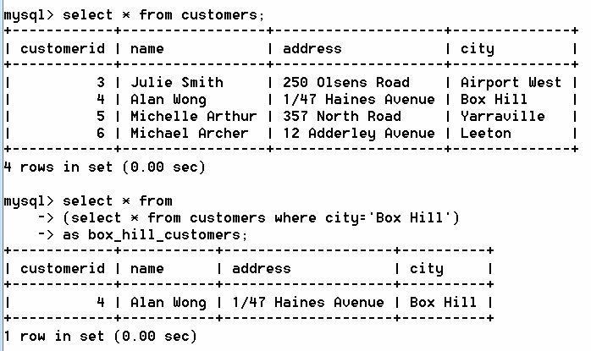
Temporary tables in sub queries
A temporary table can be used as a subquery.
For example “tablename” here is replaced by a sub query (which maps to a temporary table called “box_hill_customers”.

Slide 26
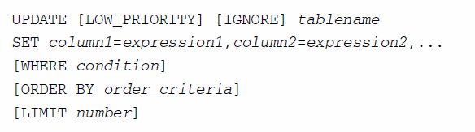
Updating Records in the Database
LOW_PRIORITY (you can wait for the server to free up)
IGNORE (ignore the errors and move on with the updates)
Tablename: the table to be updated
SET : Column Name = Value pairs
WHERE: You can limit updates to particular rows with WHERE clause
ORDER BY and LIMIT: These go together; For example, if you want to LIMIT the number of rows to be updated, then we need to order those rows first so that the LIMIT can be applied on those.

Slide 27
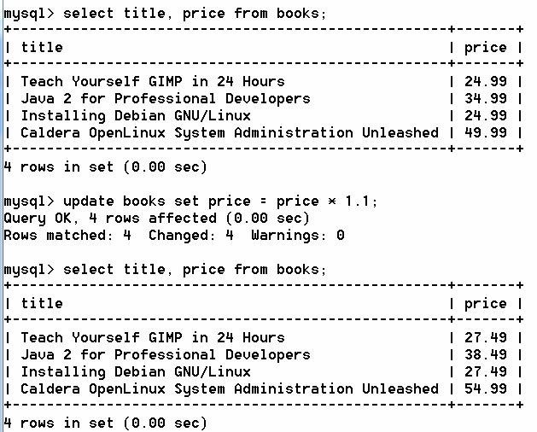
Updating Records in the Database (example 1)
Increasing the price of every book by 10%

Slide 28
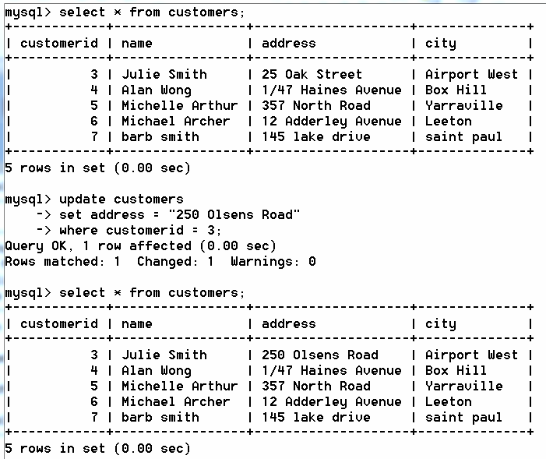
Updating Records in the Database (example 2)
Updating the address of 1 customer using WHERE clause

Slide 29
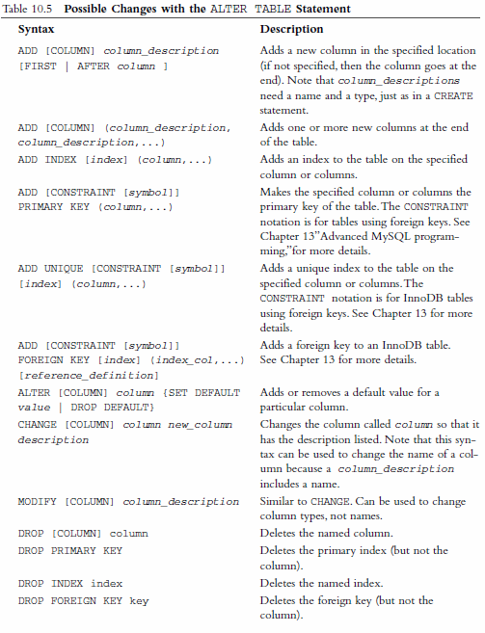
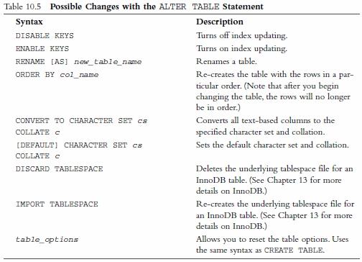
Altering Tables After Creation
Some typical scenarios:
Haven’t made a particular column “big enough”. (eg: I thought the names will be 50 characters; but some names are longer than 50)
I need another column where I can keep a tracker (selected / marked / used) on that particular row with a boolean flag.
I thought I would need that column. But I no longer need it.

Slide 30
Altering Tables After Creation
Some typical scenarios:
Haven’t made a particular column “big enough”. (eg: I thought the names will be 50 characters; but some names are longer than 50)
I need another column where I can keep a tracker (selected / marked / used) on that particular row with a boolean flag.
I thought I would need that column. But I no longer need it.

Slide 31
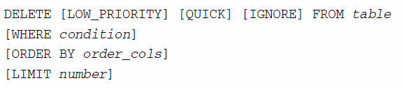
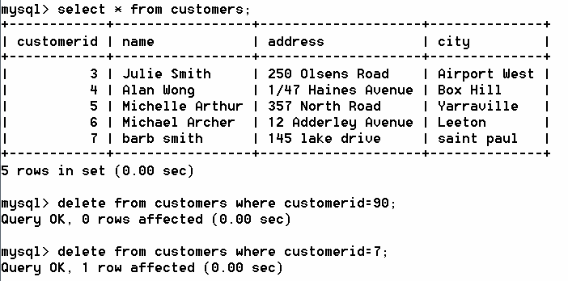
Deleting Records from the database
Make sure that WHERE clause is specified. Only those records will be deleted.
For example, you may want to delete a customer who has not logged into the system for the last one year and has not placed any orders.
Notice “__” rows affected.

Slide 32
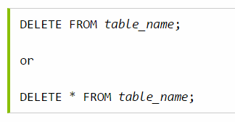
Deleting All Records from a table
(Be very careful)
It is possible to delete all rows in a table without deleting the table.
This means that the table structure, attributes, and indexes will be intact:
DELETE FROM table_name; or DELETE * FROM table_name;
Note: Be very careful when deleting records. You cannot undo this statement!

Slide 33
Dropping / Deleting the tables and databases
(Be very careful)
You can delete the tables (in a given database).
mysql> DROP TABLE tablename;
Or you can even delete the entire database.
mysql> DROP DATABASE databasename;
Entire data and schema – all will be deleted.
Be careful! These can not be undone.

Slide 34

Summary
DDL (Data Definition Language)
Creating Schema
Creating Database and Tables
DML (Data Manipulation Language)
Inserting Data
Querying for Data
Updating Data
Deleting Data
We just covered CRUD operations on the MySQL databases using Command Line prompt.
We will explore how these can be achieved through MySQL later.

Slide 35
References
SQL Tutorial at W3 Schools
http://www.w3schools.com/sql/

